Slide 1
Application Development on the Cloud

Slide 2
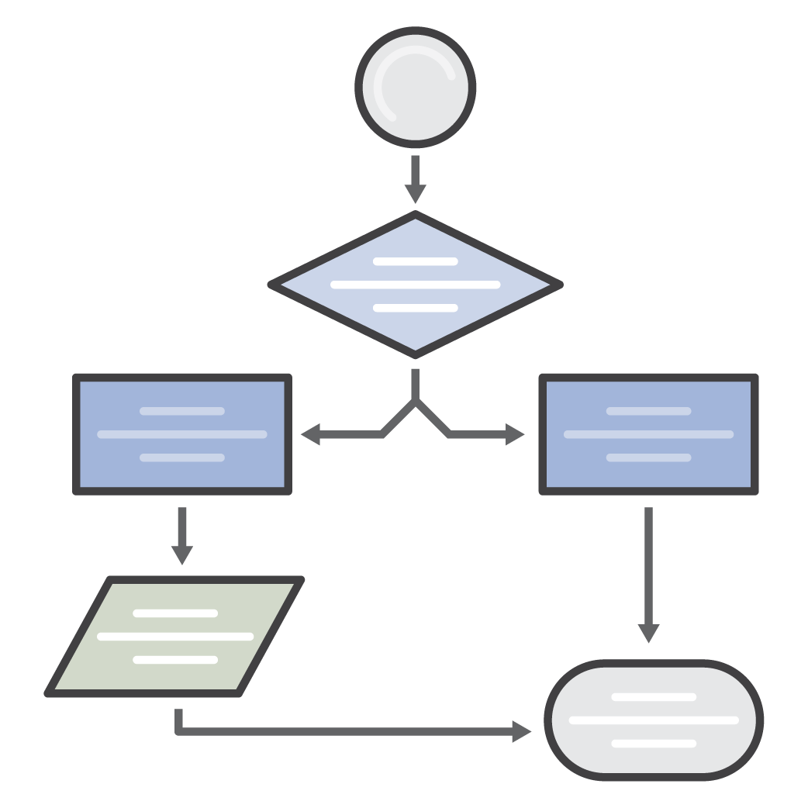
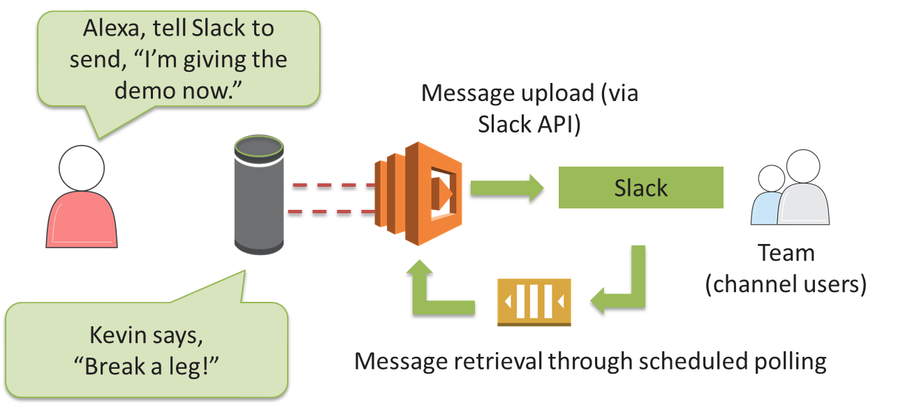
Serverless Applications
</>
</>
Web Applications
Static websites
Complex web apps
Packages for Flask and Express
Backends
Apps & services
Mobile
IoT
Data Processing
Real time
MapReduce
Batch
Chatbots
Powering chatbot logic
Amazon Alexa
Powering voice-enabled apps
Alexa Skills Kit
Autonomous IT
Policy engines
Extending AWS services
Infrastructure management

Slide 3
Simplifying Development Workflow

Slide 4
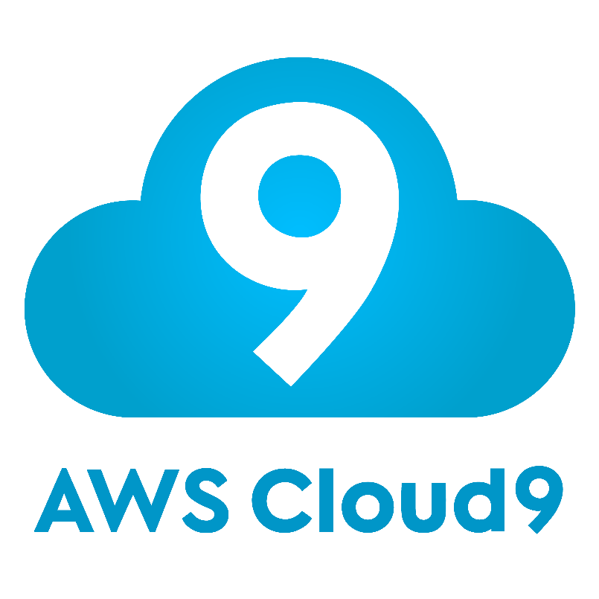
Ideate
Specification
Backlog
Code
Design
Quick Prototyping
Distributed Development

Slide 5


Innovate
Code Review
Build
Test
Build faster
Code
Code Repository
Pipeline
Build Consistently
Build Better

Slide 6



Maintain
Build
Deploy
Pipeline
Risk free Deployments
Deployments at business speed

Slide 7
AWS CodeStar
AWS CodeBuild
AWS CodeCommit
AWS CodePipeline
AWS CodeDeploy
Notes:
AWS Developer Tools as vehicle for stable deliveries
Code that’s secure
Code that builds reliably faster
Code that gets deployed gracefully
Find and Remedy issues

Slide 8
Thank You

Slide 9
Additional Content
AWS re:Invent 2017 Sessions on Youtube
https://www.youtube.com/results?search_query=%22AWS+re%3Ainvent+2017%22+
DEV206 Life of a Code Change to a Tier 1 Service
DEV305 Learn how to deploy and scale web applications on AWS
DEV307 AWS CLI: 2017 and Beyond
DEV317 Deep Dive on AWS CloudFormation
DEV322 Continuous Integration Best Practices for Software Development Teams
DEV323 Introduction to the AWS CLI
DEV325 Application Deployment Techniques for Amazon EC2 Workloads with AWS CodeDeploy
DEV342 Achieving DevOps with Microservices-Based Architectures

Slide 10
Additional Resources
AWS DevOps Workshop:
https://s3.amazonaws.com/aws-devops-workshop/site/index.html
Integrating Git with AWS CodePipeline:
https://aws.amazon.com/blogs/devops/integrating-git-with-aws-codepipeline/
AWS CodeStar: https://aws.amazon.com/codestar
AWS CodeBuild: https://aws.amazon.com/codebuild
AWS CodeCommit: https://aws.amazon.com/codecommit
AWS CodeDeploy: https://aws.amazon.com/codedeploy
AWS CodePipeline: https://aws.amazon.com/codepipeline

